Slide 1
Atomic Theory
By
Sepalika Kularatne

Slide 2
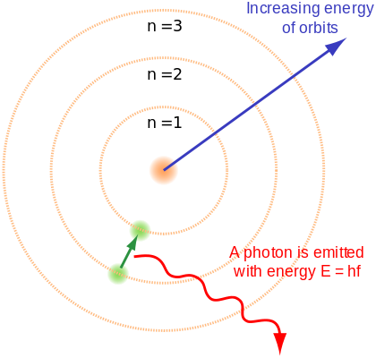
Bohr Theory
Bohr used H atom as the model
1 electron . And 1 proton.
Electrons are moving in orbitals(shells). Each shell has a specific energy
Ground state is when the electron is at
the lowest energy state, this is where n = 1,
Excited state is when the electron is in the higher energy shells
(above the lowest energy level = ground state)
Electron needs to absorb energy(shock or electricity)
to get to higher energy levels.
Energy is released when elns jump(or drops) from excited states (n= 2, 3, 4) to the ground state. This energy converts to different waves and are visible as different color spectra.

Slide 3
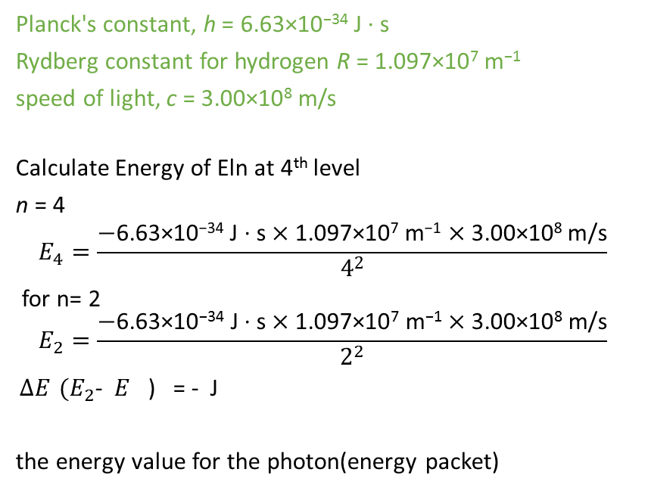
Calculations: Enthalpy change for electrons between shells
How much energy is released when an electron is dropped from 4th energy level to 2nd energy level
You can do this problem in two ways
Method 1
Energy of an electron in n energy level
$E_{n}=\frac{−R_{h}×h×c}{n^{2}}$
You have to calculate two energy values separately for n= 2 and n=4 E₄ and E₂ respectively
Then by subtracting two(E₄ –E₂ )values will give you the ΔE
Value always negative.
It has nothing to do with mathematical + or – it means energy is given out(exothermic)
This released energy will match a wavelength of some range in the spectrum
from the value of wavelength you can get what color line you can see there.
Planck's constant, h = 6.63×10⁻³⁴ J · s
Rydberg constant for hydrogen R = 1.097×10⁷ m⁻¹
speed of light, c = 3.00×10⁸ m/s
Calculate Energy of Eln at 4th level
n = 4
$$E_{4}=\frac{−\text{6.63×10}\text{−34} \text{J}\text{ · }\text{s}×\text{1.097×10}\text{7} \text{m}\text{−1}×\text{3.00×10}\text{8} \text{m}\text{/}\text{s}}{4^{2}}$$
for n= 2
$$E_{2}=\frac{−\text{6.63×10}\text{−34} \text{J}\text{ · }\text{s}×\text{1.097×10}\text{7} \text{m}\text{−1}×\text{3.00×10}\text{8} \text{m}\text{/}\text{s}}{2^{2}}$$
$ΔE$ ${(E}_{2}$- $E_{}$) = - J
the energy value for the photon(energy packet)

Slide 4
Method 2
You can directly calculate the value for $ΔE$ using the following equation
n_{initial} = 4 ,
n_{final} = 2
Planck's constant, h = 6.63×10⁻³⁴ J · s
Rydberg constant for hydrogen R = 1.097×10⁷ m⁻¹
speed of light, c = 3.00×10⁸ m/s
$ΔE=\frac{\text{6.63×10}\text{−34} \text{J}\text{ · }\text{s}×\text{1.097×10}\text{7} \text{m}\text{−1}×\text{3.00×10}\text{8} \text{m}\text{/}\text{s}}{(4 −16)}$
$ΔE$ = Negative value (energy released)
When an electron is going from ground state to an excited state. Same method should be followed
$ΔE$ = Positive value (it indicates electron will have to absorb energy

Slide 5
Calculating the wave length of the photon
$\frac{\begin{aligned} \\ \\ \\ 1\end{aligned}}{λ}$ = 1523611 => λ = 6.56 X 10⁻⁷ = 656 X 10 -⁹656 nm
this is the red light in the Balmer series.
All the Balmer series lines are due to energy transfers from outer shells to the second orbital
n 3→2 = 656 nm - red line
n 4 → 2 = 486 nm - bluegreen
n 5→ 2 = 434 nm - blue
n 6→ 2 = 410 nm - violet
Similarly you can calculate the wave lengths for energy transfers between different energy levels.
Depending on the wave length of the photon, you can say which spectrum it belongs to
Eg n 2 → 1 = 122 nm
(it doesn’t emit light, because it is not visible because it are UV light range. Similarly other transitions will genereate photons of other quntum regions white light region or Radio waves.
What wave length of light is emitted when an electron is dropped from n= 3 to n= 2
Wave length of an electron(using Balmer-Rhyberg equation)
Hydrogen spectrum has only 4 lines.
It is not continuous. Therefore It is called a line spectrum(not a continuous spectrum)
Rydberg constant for hydrogen R = 1.097×10⁷ m⁻¹
λ = Wave length of photon
n₁ → eln in the lower energy level = 2
n₂ → eln in the higher energy level = 4
$$\frac{1}{λ}=R_{h} (\frac{1}{n_{1}^{2}}−\frac{1}{{n_{2}}^{2}})$$
$$\frac{1}{λ}={\text{1.097×10}\text{7} \text{m}\text{−1}}_{} (\frac{1}{2_{}^{2}}−\frac{1}{{3_{}}^{2}})$$

Slide 6
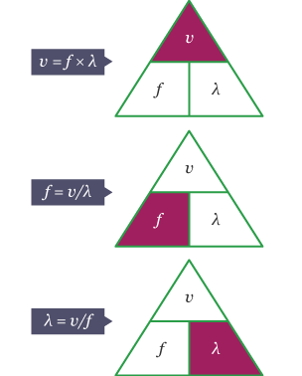
Electromagnetic calculations Frequency, Wave lengths, and velocity of light and Energy
How to calculate frequency from wave length
C = λ v
v$=\frac{c}{λ}$
C= speed of light 3.0 X 10⁸ m/s
h = Plank’s constant 6.626 X 10 ⁻³⁴ J.s
V = frequency of the electro magnetic wave

Slide 7
i) What is the frequency of purple light if the wave length is 410nm
Write down your knowns
λ = 410 nm => 4.10X 10 ⁻⁹ m
V = frequency ? Hz (1/s or sec – ¹)
C= 3.0 X 10⁸ m/s
h = 6.626 X 10 ⁻³⁴ J.s Plank’s constant
C = λ v => v$=\frac{c}{λ}$
= (3.0 x 10⁸ ms⁻¹ )
4.10 X 10⁻⁷ m
⁼ 7.3170 X 10 ¹⁴ s^{-1ii}
ii) How to calculate energy from wavelength-electromagnetic radiation
Calculate energy (in kJ) of purple light(visible light range) with a wave length of 410 nm
(because it is in the range of visible light range purple wave will travel in the speed of light )
C = λ v
E = h v
You can derive a new equation =>
E = hc ?
λ
E =(6.626 X 10 ⁻³⁴ J.s) X (3.0 x 10⁸ ms⁻¹ )= 4.848 X 10⁻²² kJ
4.10X 10 ⁻⁹ m

Slide 8
problems

Slide 9
Per molecular energy
E = hc N_{A}
λ
N_{A = Avagadro constant =} 6.02 X 10²³ mol⁻¹

